Slide 1
The Quick Wash
By
Ansh Srivastava
Naman Raj
Dipanshu Kumar
Gautam Kumar
Abstract
Online 24*7 laundry services for hostelites, faculties and for those whose time is more worthy.
Sector: Business Sector
Stage: At Opening Stage
Contact us- 7488313701
Email : srivastava761@gmail.com
City: Darbhanga(Bihar)

Slide 2
Problems
Just a Sunday is not enough for these types of activities. This should be the day for our creativities and extracurricular activities.
Hostelites have to go to washerman.
After giving clothes , one has to wait around 3-4 days for the returning.
Damage of quality of fabrics of clothes and the color of fabrics.
Dirty and impure water is used for washing purposes.
Problems

Slide 3
Solution
No worries for the extra work load of cloth maintenance.
Time will be saved, just a click away.
Any time, any day- 24*7.
Economical: Free delivery and pickups.
Hygienic
Qualities of cloth fabrics will be maintained. Because machine will be used for cleaning not a bat.
Color of the cloth will also be protected because most of the water will be drained and dried in the machine drier.

Slide 4
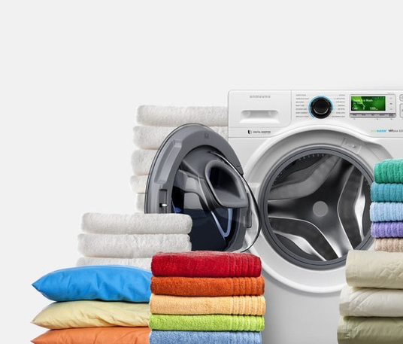
To solve the previous problem we are introducing …
THE QUICK WASH

Slide 5
Wash
Quick
The
Gaining your trust
We will provide the best service to you.
24*7 day service.
Maintain the quality of your clothes.
Deliver the clothes before 24 hr.

Slide 6
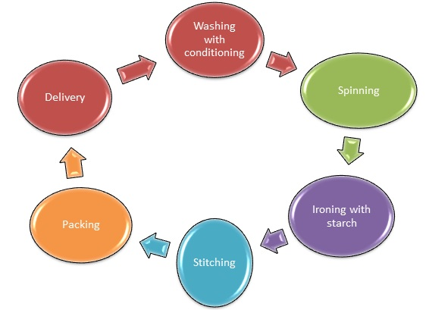
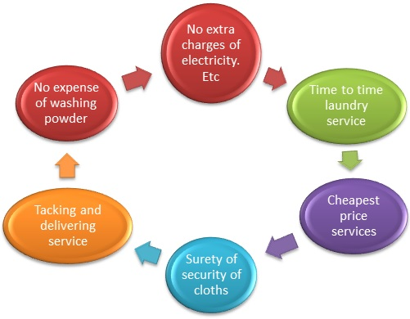

Slide 7
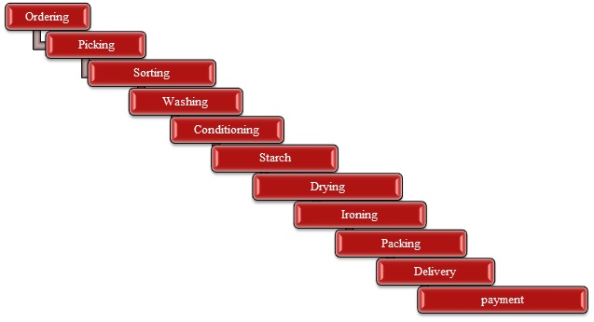
Functioning of our service :

Slide 8
Target customer
In the beginning our services will be more specific for the hostelers of different colleges of the town like:
DCE, Darbhanga
DMCH, Darbhanga
CM Science college
LNMU etc.
Additional facilities like online tailoring services.
Customised tailoring on customer’s demand.
Later facilities will be extended as per the convenience.

Slide 9
Source of Funding
Sl no. | Source | Expected Amount(Rs) | Name of Institution/Bank | Remark
1 | Own
2 | Friends
3 | Seed Capital | 5-10 Lakhs
4 | Loans
5 | Grants
6 | DCE, Startup Cell | Upto 15,000

Slide 10




Slide 11
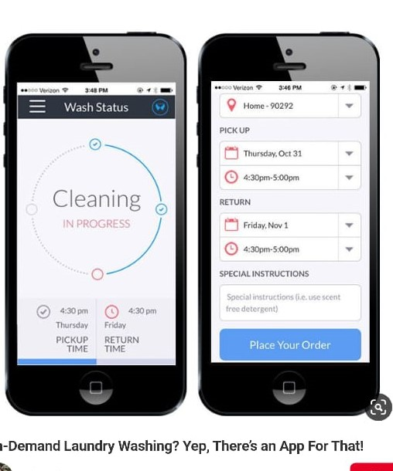

Here we have a prototype of our upcoming service app.

Slide 12
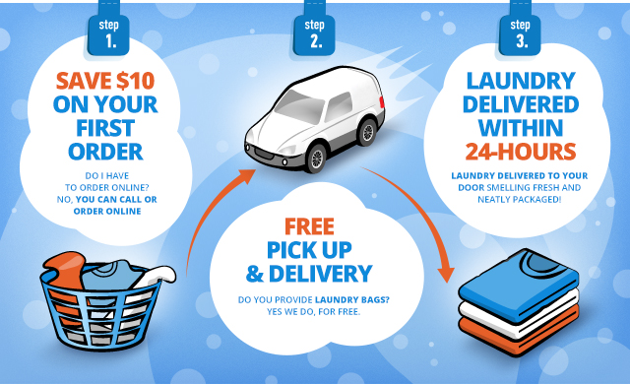

Slide 13
Thank you :

